Slide 1


A wind tunnel for kids…
Status Update
February 2, 2012

Slide 2
Activities this week
Hardware work
Arduino communication protocol development (Utah)
Motor control (Tennessee)
Arduino software development
Prototype protocol for communication with Android
Arduino-hosted web-server prototyped
Android development
Began design of exhibit flow
Experimenting with audio playback for exhibit narration

Slide 3
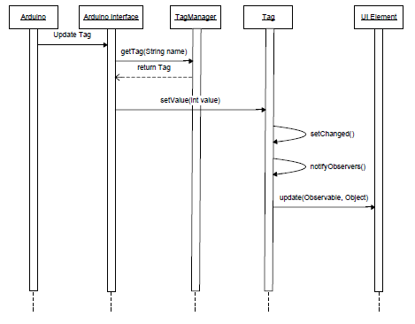
Protocol Sequence Diagram

Slide 4
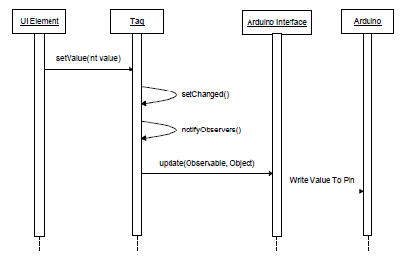
Protocol Sequence Diagram pt2

Slide 5
Baseline Documentation Metrics
Metric | Value | Notes
# Developer Documents | 5 | SoW, SDP, SRS, SDD, Fall FQT
# Administrator Documents | 0
# Pages | 47
# Status Presentation Slides | 93

Slide 6
Baseline Code Metrics
Metric | Value | Notes
SLOC (Physical) | 9092
SLOC (Logical) | 6693
# Source Files | 97 | File types included: .h, .cpp, .java, .xml, .pde

Slide 7
Baseline Hardware Metrics
Metric | Value | Notes
# Sensors Prototyped | 3 | Temperature, Humidity, Hall Effect
# Control Elements Prototyped | 1 | Motor Control
# Sensors Integrated | 1 | Hall Effect
# Control Elements Integrated | 1 | Motor Control

Slide 8
Motor Control
Motor control from Arduino
Next step: integrate with Android
http://www.youtube.com/watch?v=Gfxle2GRxBk
Video is of motor controlling fan control box

Slide 9


Follow us on Twitter… 7 followers – 47 tweets
@TunnelK
Notes:
Initial social network of choice…

